Slide 1
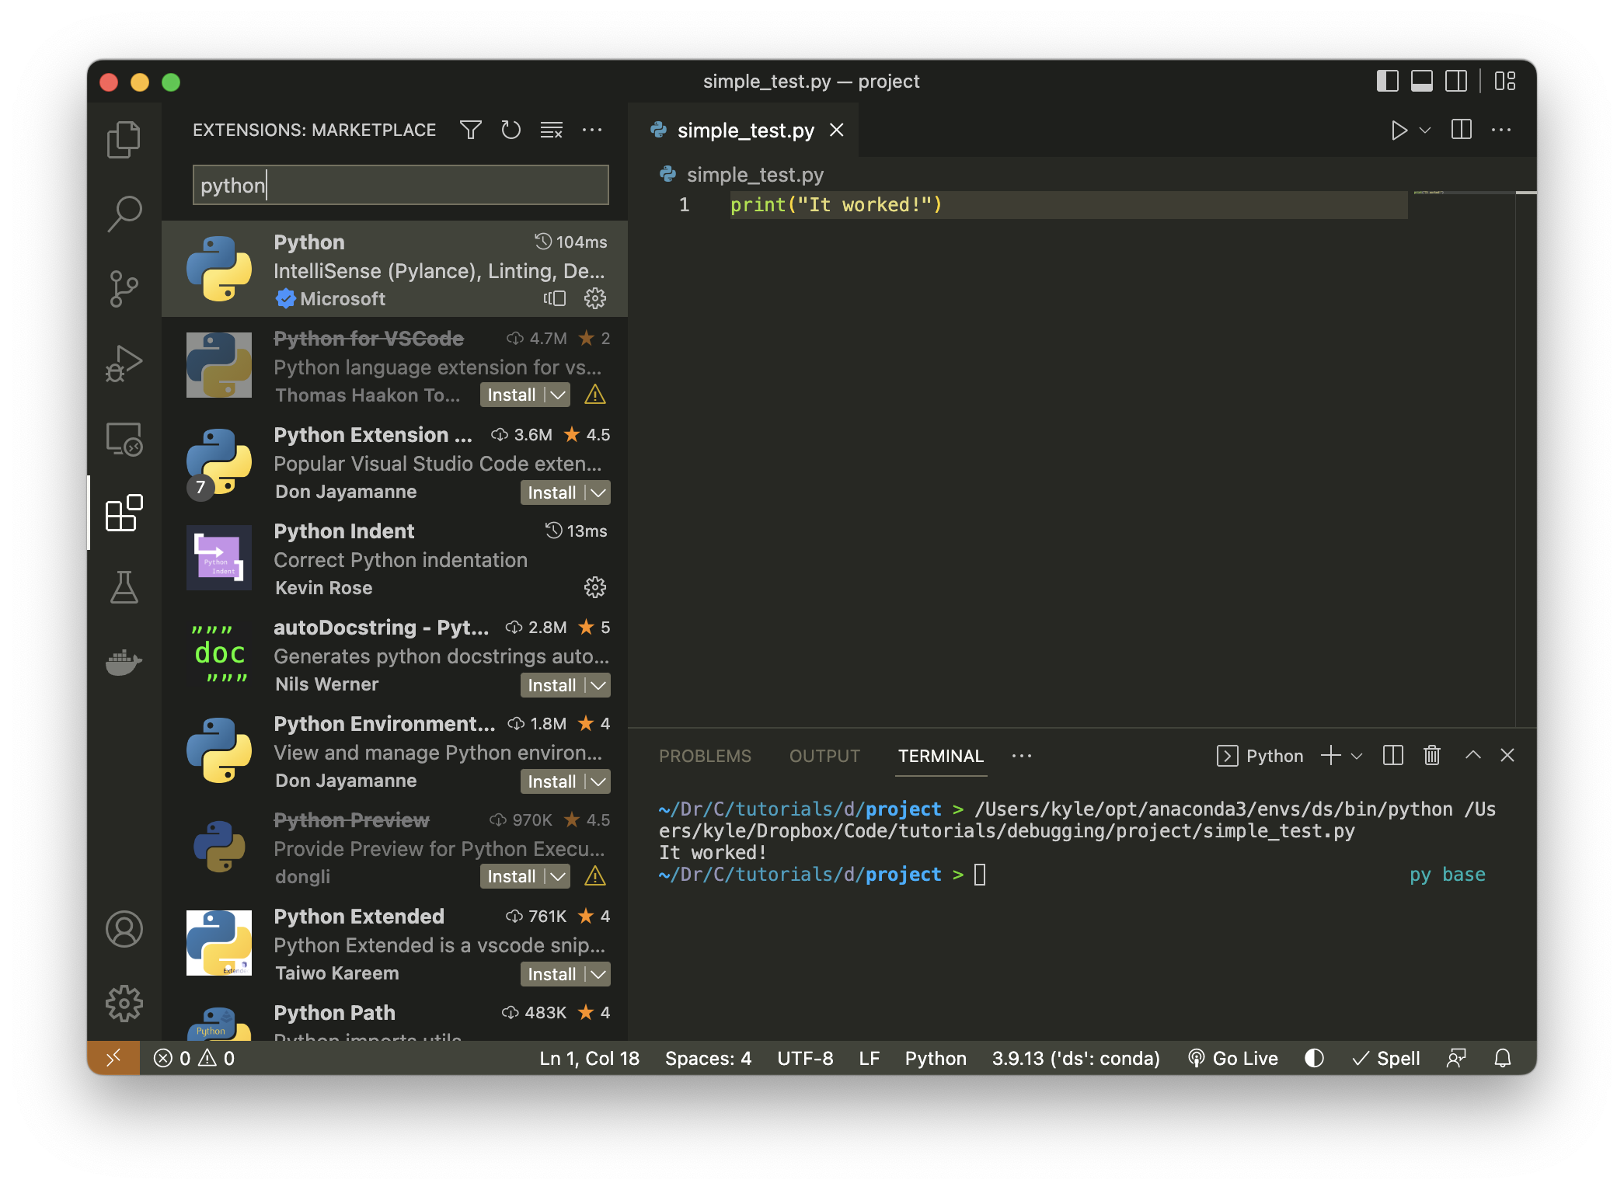
5
2
1
3
6
4

Slide 2
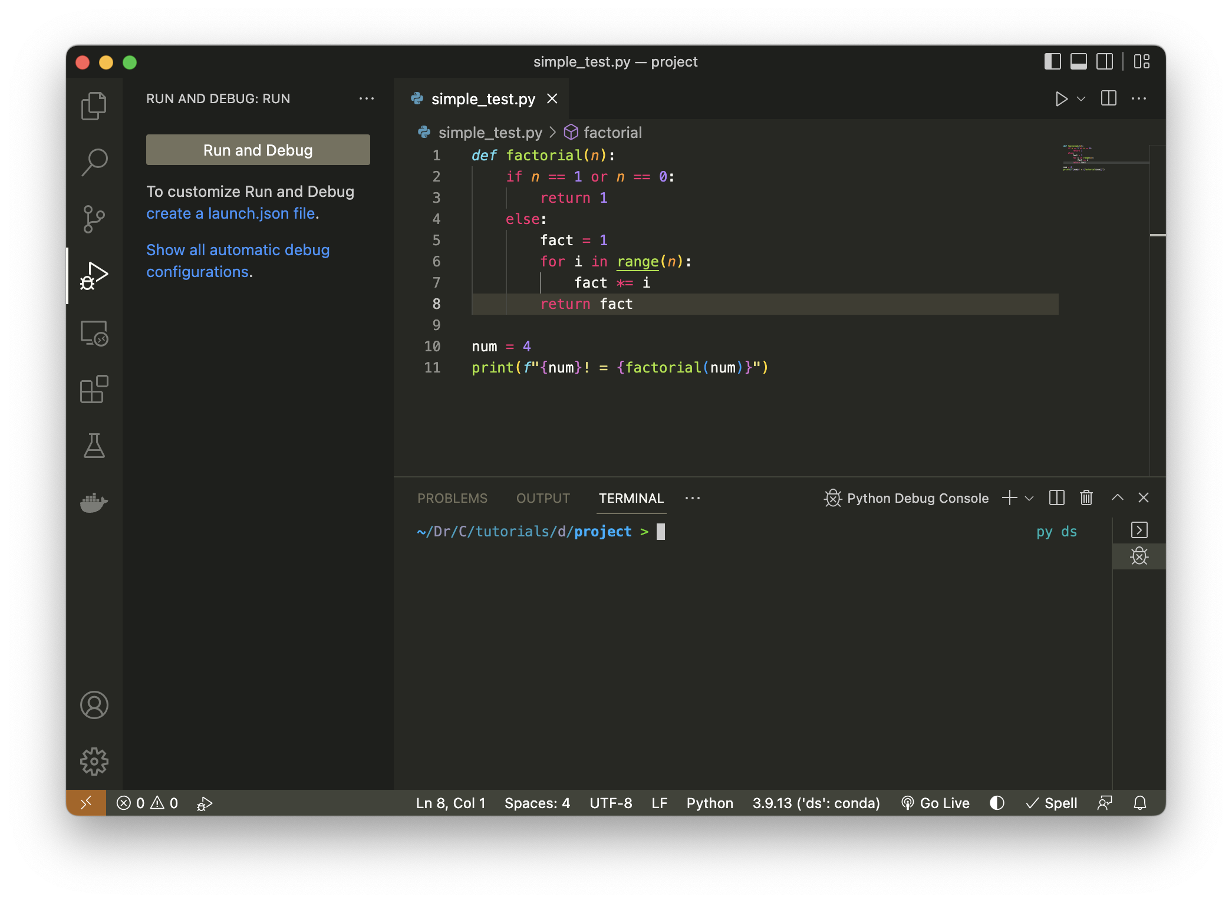
1
2

Slide 3
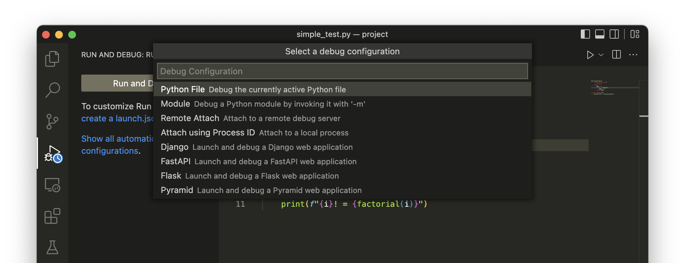
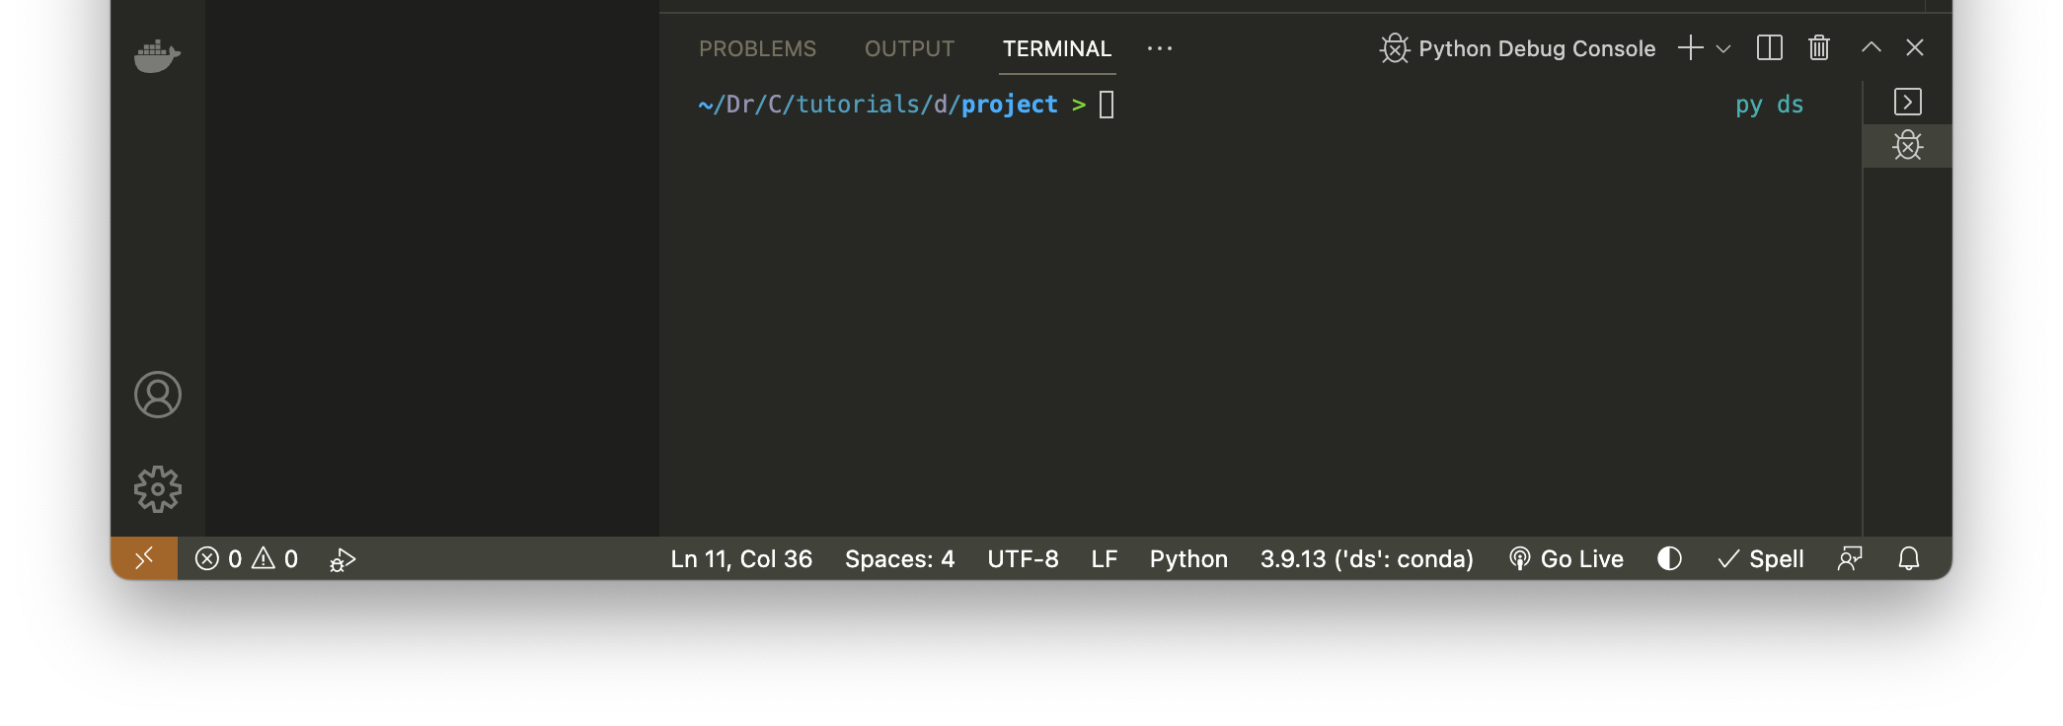

Slide 4
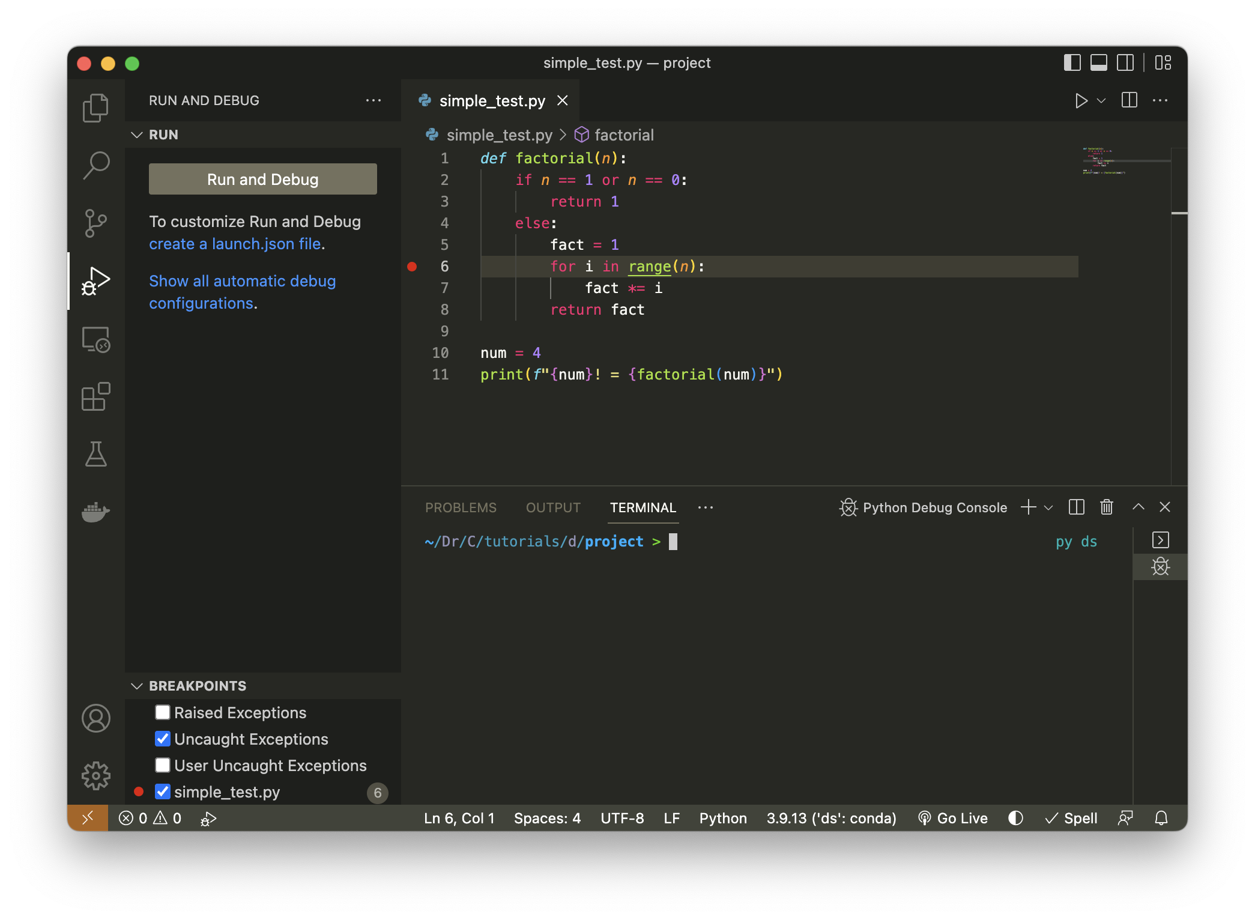
2
1

Slide 5
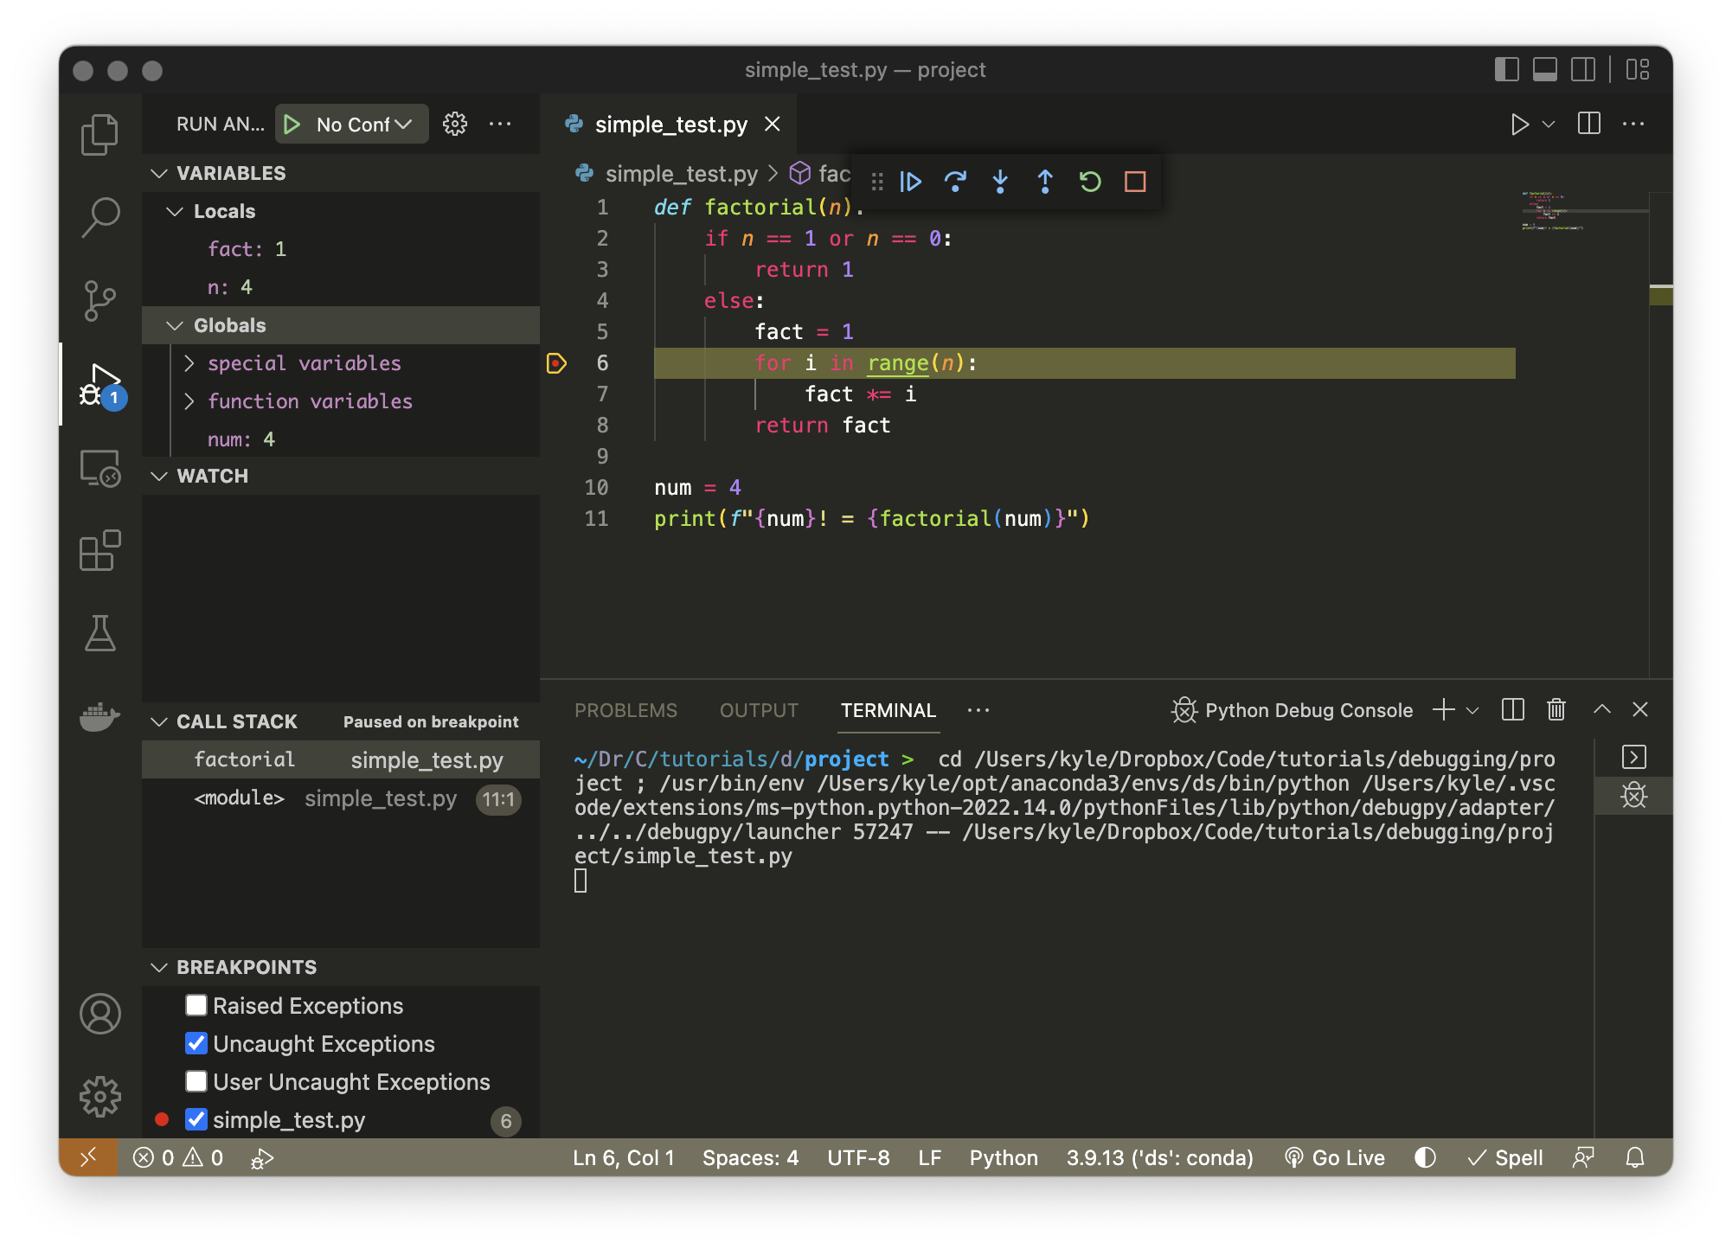
Step Over
Step Into
Continue
Step Out
Restart
Stop
4
3
1
2

Slide 6
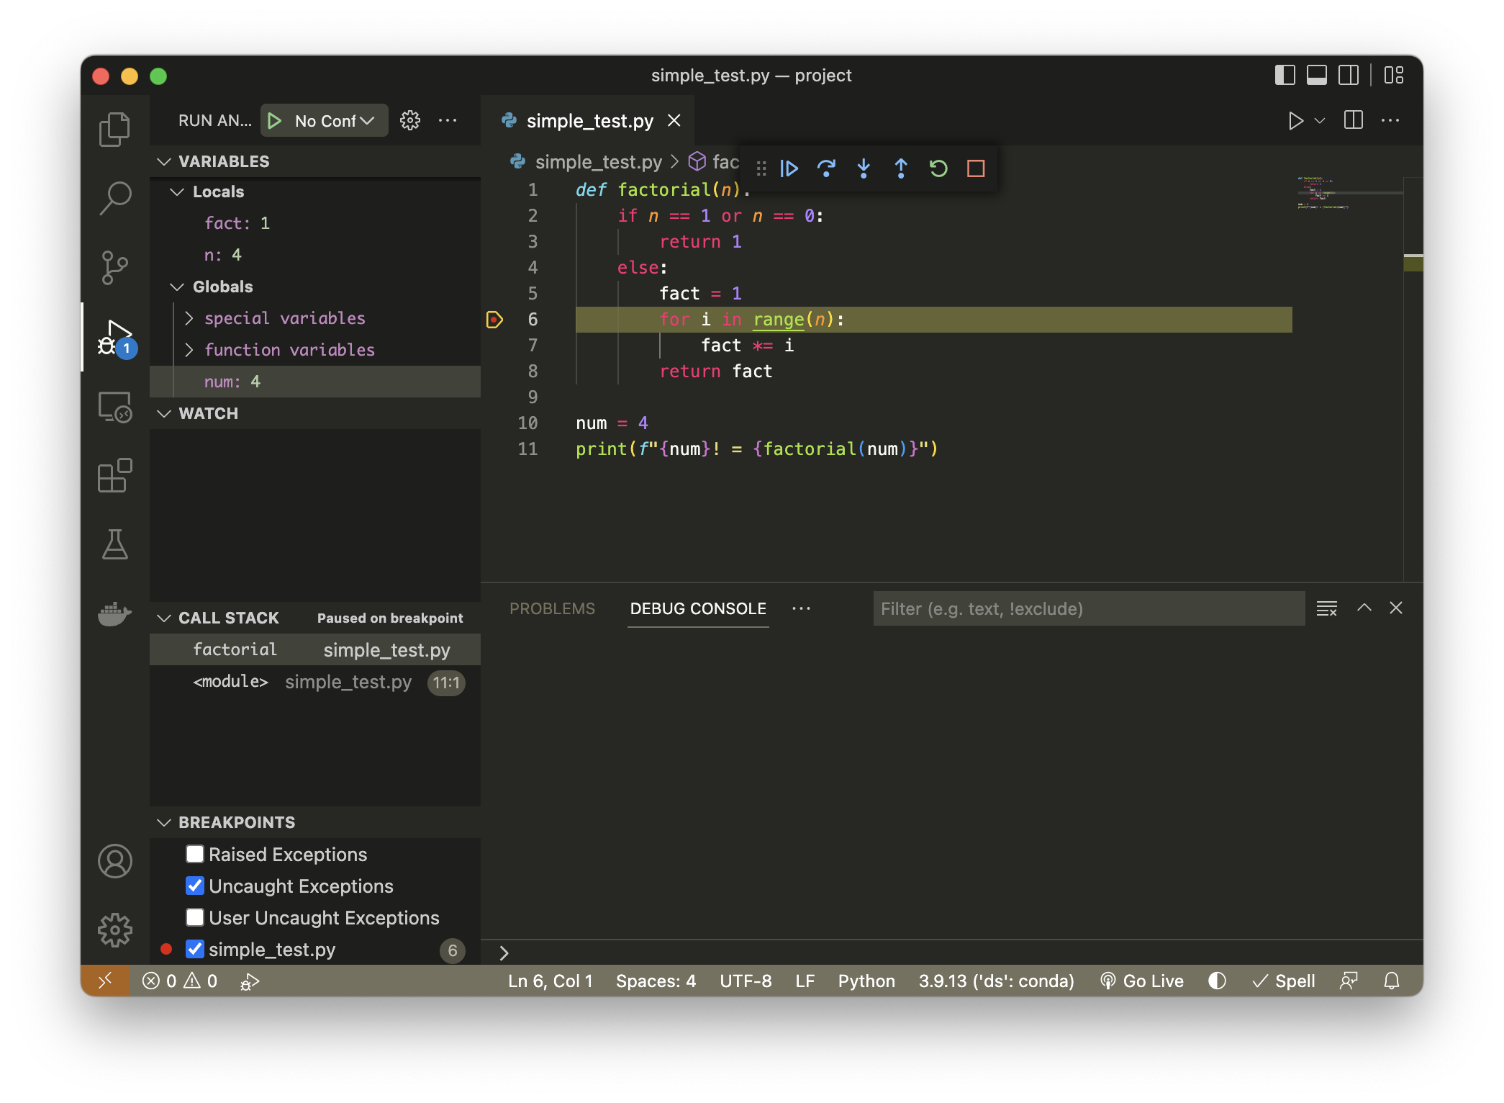
Step Over
Step Into
Continue
Step Out
Restart
Stop
1
3
2
4
5
6

Slide 7
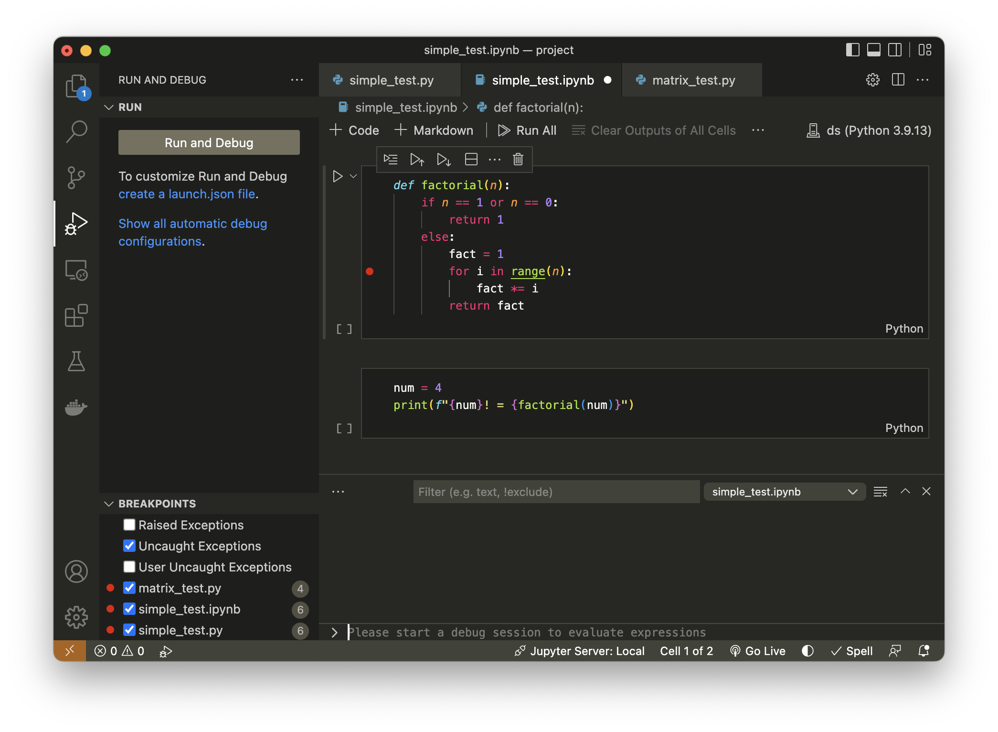
3
2
1

Slide 8
